Slide 1
Virtual chemistry Lab

Slide 2
Submitted By:-
Omar Abdel Nasser Ibraheem 404077
Yusuf Ashour Abdelrahman 404145
Ammar Mahmoud Mohamed 404074
Abdalla Ehab Salem Matar 404066
Yasser Ahmed Ahmed Issa 404139

Slide 3
Topics discussed :-
introduction
objectives
Conclusion
Methodology
Users
use cases
Initial Design
Unity Work
Back-end work

Slide 4
introduction
welcome to our virtual chemistry lab presentation. In this project, we have developed a virtual laboratory experience that simulates real-world chemistry experiments and provides a safe and accessible alternative to traditional physical labs, particularly for remote or distance learning environments.
The virtual chemistry lab provides a cost-effective and engaging way for students to explore and experiment with chemical reactions and properties in a virtual environment. The lab offers interactive simulations, and other resources that enable students to conduct experiments, analyze results, and draw conclusions in a safe and controlled setting.

Slide 5
introduction
In this presentation, we will demonstrate the features and functionality of the virtual chemistry lab, including the various experiments that can be performed, and the benefits of using a virtual lab for chemistry education. We will also discuss the methodology used to develop the virtual lab and the challenges encountered during the development process.
Overall, this virtual chemistry lab project has the potential to enhance the quality of chemistry education and increase access to laboratory experiences for students around the world. Thank you for joining us today and we look forward to sharing our project with you.

Slide 6
Objectives:
Virtual labs have become increasingly popular in recent years due to their many advantages over traditional, physical labs. Here are some reasons why virtual labs are beneficial:
Accessibility: Virtual labs can be accessed from anywhere with an internet connection, making it possible for students to conduct experiments and learn scientific concepts even if they don't have access to a physical lab.
Cost-effectiveness: Virtual labs can be significantly cheaper than building and maintaining physical labs, which can be costly to equip with specialized equipment and maintain.

Slide 7
Objectives:
Safety: Virtual labs eliminate the need for students to handle potentially dangerous chemicals or equipment, reducing the risk of accidents or injuries.
Reproducibility: Virtual labs can be replicated multiple times, ensuring that all students have access to the same experiment and the same learning opportunities.
Flexibility: Virtual labs can be designed to simulate a wide range of experiments, allowing students to explore various scientific concepts and phenomena.

Slide 8
Conclusion
Limitations of traditional labs:
Time
Money
Equipment availability
Safety concerns
Limited space
Virtual lab exercises can nearly eliminate all these concerns!

Slide 9
Methodology
Definition of the objectives: we Started by defining the objectives of the virtual chemistry lab project. Then Identifying the target audience, the types of experiments that will be performed, and the features and functionality that will be included.
In this early stage of the project, we included some key consideration such as:
Target audience: Who is the virtual chemistry lab intended for ?
This include students at different levels of education, teachers, or researchers.

Slide 10
Methodology
Learning outcomes: What are the desired learning outcomes of the virtual lab? For example, is the objective to teach fundamental concepts in chemistry, to provide practical laboratory experience, or to enhance critical thinking skills?​
​
Platform and technology: What platform and technology will be used to develop the virtual lab? This will depend on the learning objectives and the target audience, as well as the available resources and technical expertise.​
​
By defining the objectives of the virtual chemistry lab project, developers can ensure that the project is focused and aligned with the needs of the target audience. This can help to ensure the success of the project and the effectiveness of the virtual lab in achieving its intended outcomes.

Slide 11
Methodology
Planning the project:
Here are some key steps involved in planning the virtual chemistry lab project:
Defining the project scope
Developing a timeline
Identifying the resources needed
Assigning roles and responsibilities
Developing a communication plan

Slide 12
Methodology
By planning the project in detail, we can ensure that the project is completed successfully, on time. In addition, a well-planned project can help to reduce the risks and challenges associated with the development of a virtual chemistry lab and ensure that the project meets the defined objectives we specified above.
Choosing the development platform
When developing a virtual chemistry lab project, choosing the right development platform is critical to the success of the project. The development platform will determine the tools and resources that can be used to create the virtual lab and will also impact the functionality and user experience of the lab.

Slide 13
Methodology
We decided to use Unity a cross-platform game engine and development platform which is used to create 2D and 3D video games and interactive experiences for multiple platforms, including desktop computers, mobile devices, and gaming consoles.
Why Unity?
1- Beginner-friendly : Easy to learn and use.
2- Cross-Platform Engine : More platforms supported
3- Unity has a more large and active community
4- Huge amount of assets ready to use

Slide 14
Methodology
Testing and refining
Testing and refining the virtual chemistry lab is a critical step in ensuring that the lab is effective in achieving its learning objectives and providing an engaging and immersive learning experience.
This step was divided into two separate processes
1- Test the lab with a diverse group of users: those users included friends and students in faculty of science and of course our supervisor.
2- Refining the lab based on feedbacks: we used the feedbacks to refine the lab, making improvements to the user interface, instructions, simulations, and other elements as needed.

Slide 15
Type of users
Teacher :
Functionalities:
Create an experiment
Provide a video or animation to explain the experiment and how the student can do it.
Student :
Functionalities:
Watch the animation provided by the teacher.
Do the experiment as the teacher explains.

Slide 16
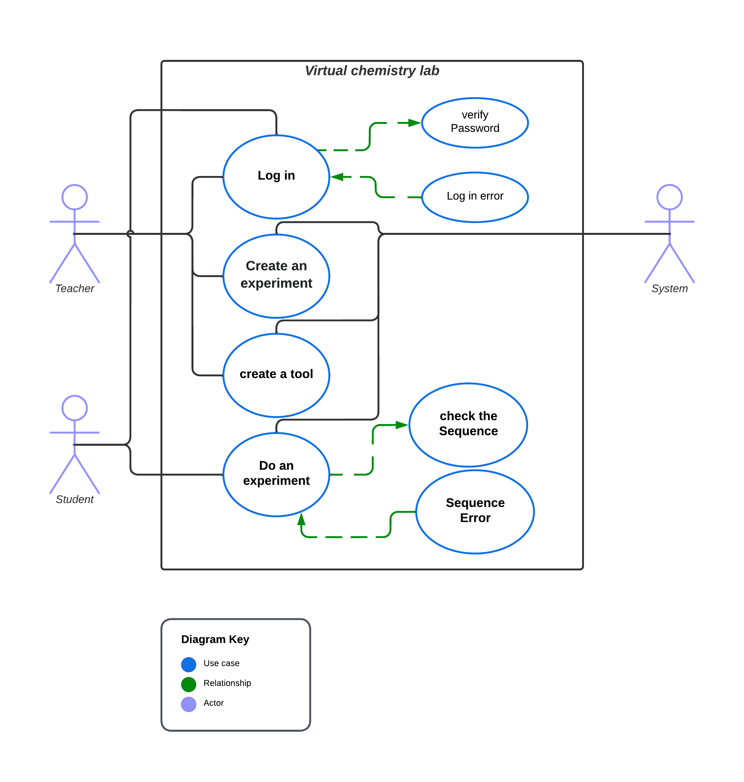

Slide 17
Use cases
Both teacher and student have an account so they will login at the beginning to restore their last session data
Teacher can create a brand-new experiment or use an existing one
Student just do the experiment that teacher has chosen
After the student do the experiment, the system will verify if the student did it as the teacher did or not

Slide 18
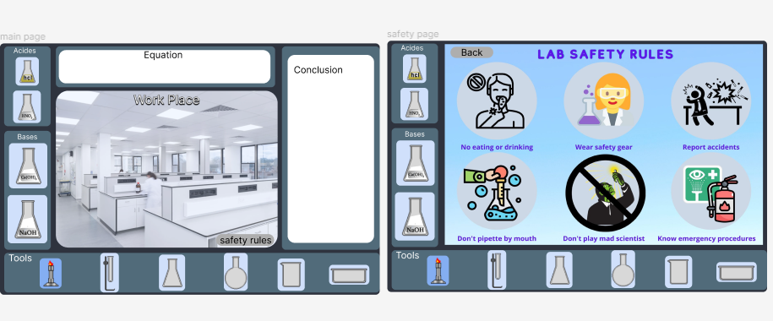
Initial Design

Slide 19
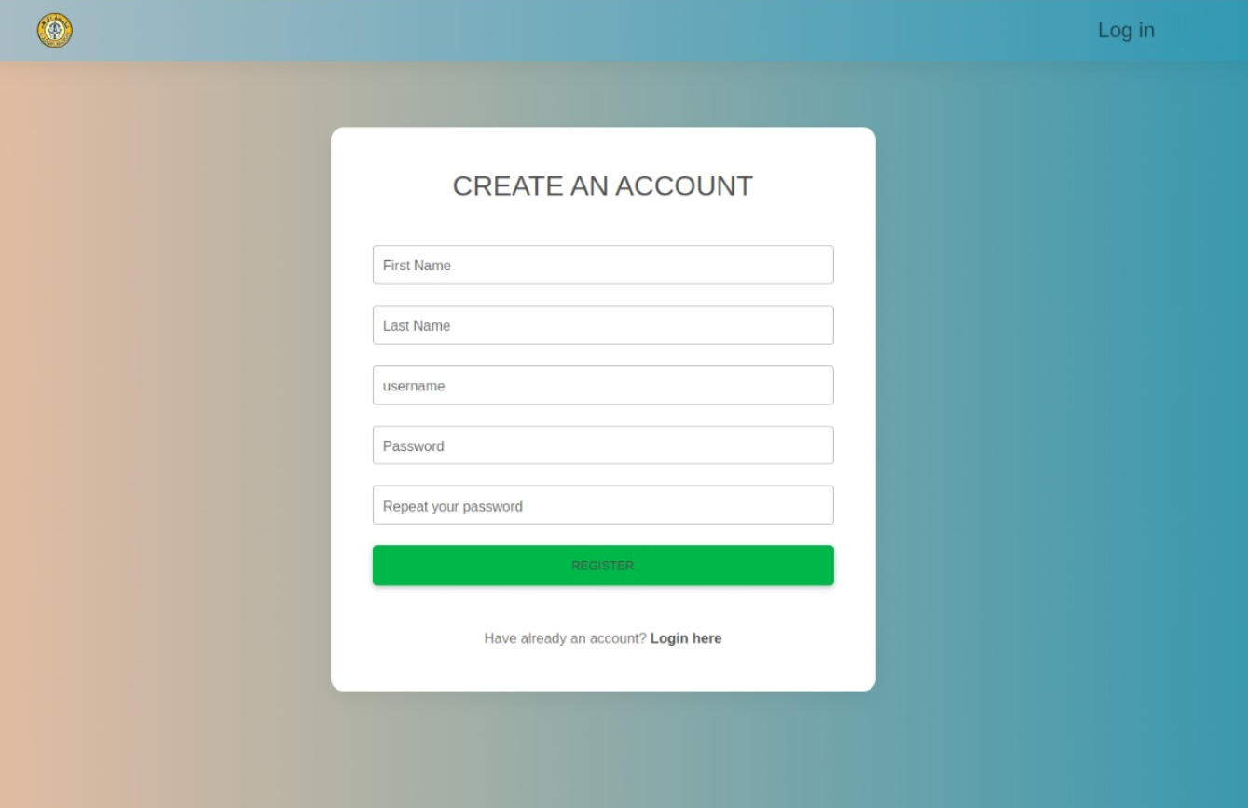

Slide 20
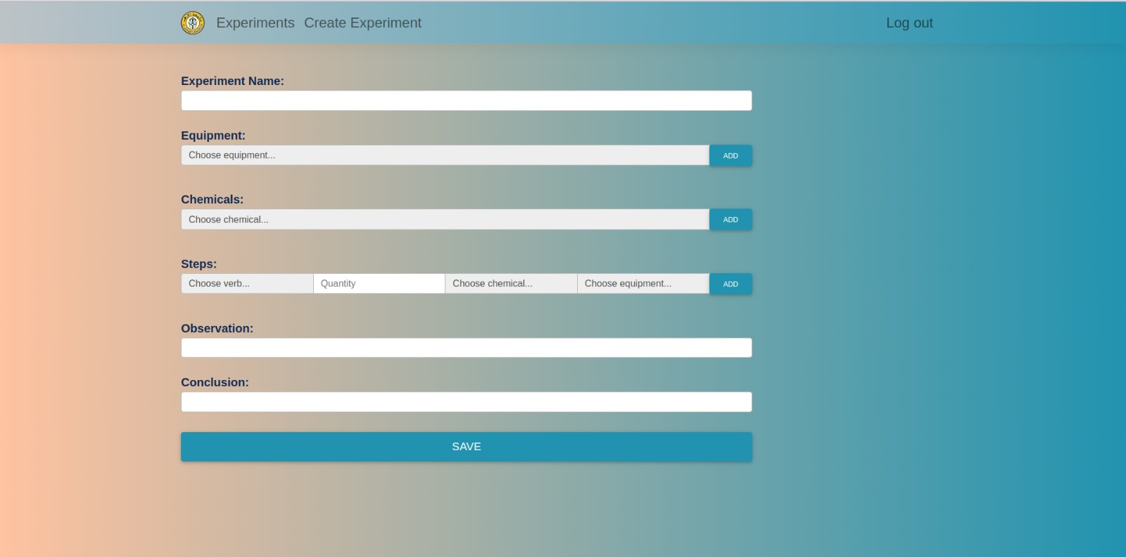

Slide 21
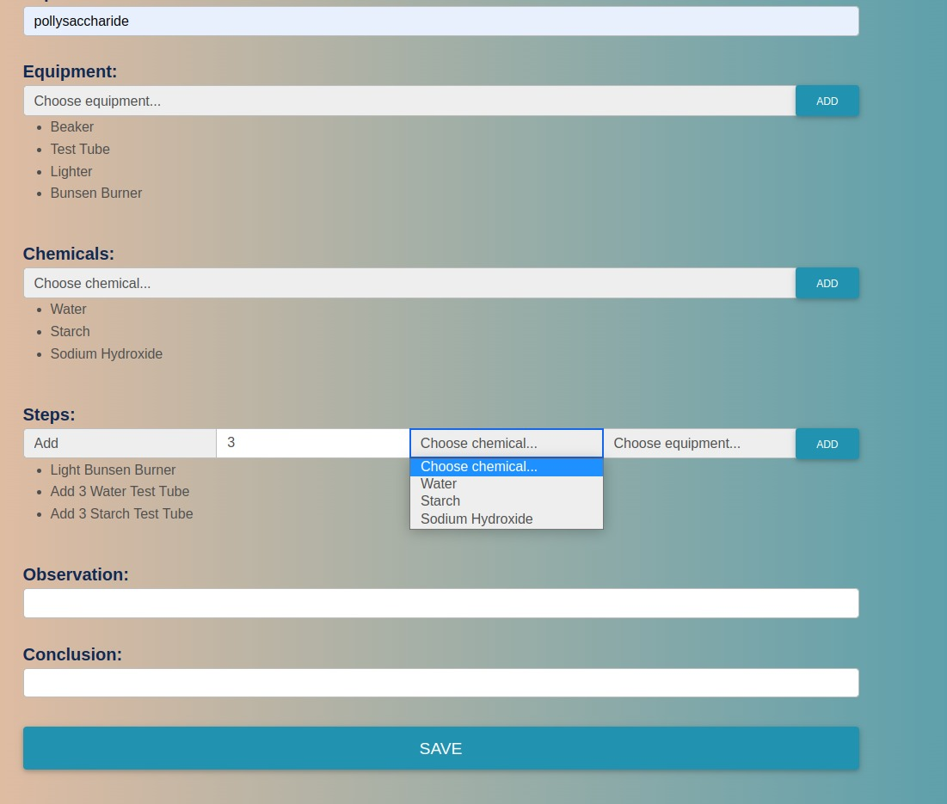

Slide 22
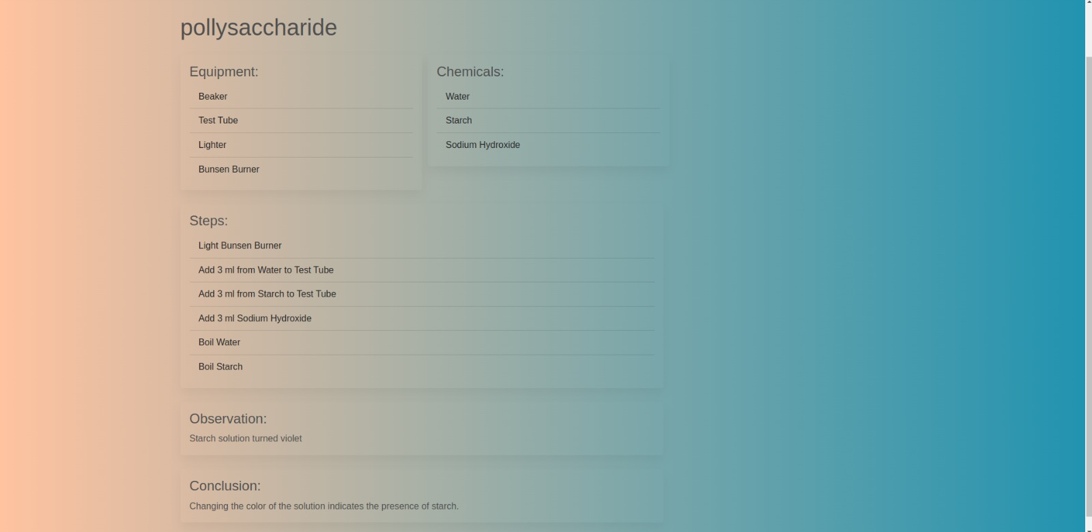

Slide 23
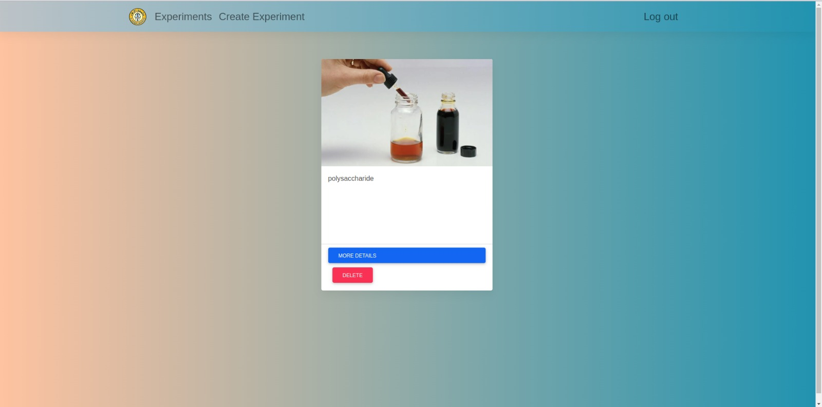

Slide 24
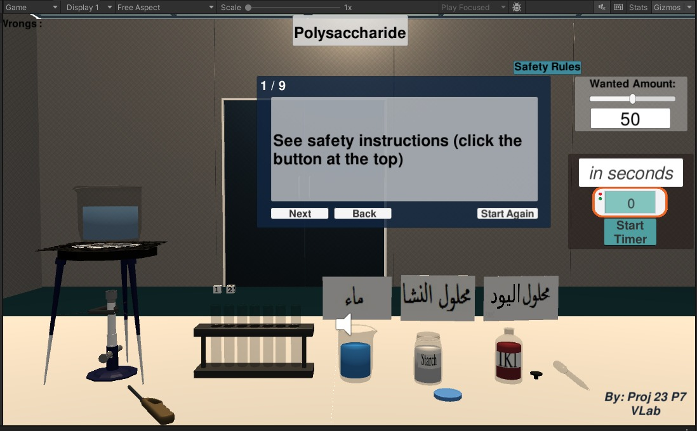

Slide 25


Slide 26
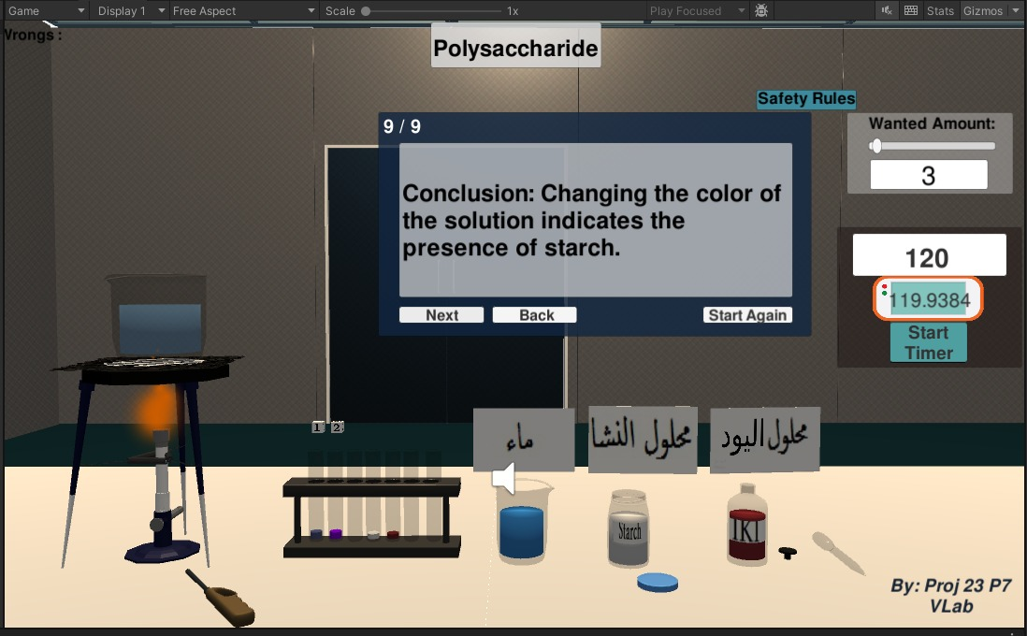

Slide 27
Thank you

